Slide 1

MINI PROJECT
C PROGRAMMING
Banking Management System
A console-based banking application built in C, leveraging Structures and File Handling for persistent, secure account management.
Team Members
Sam Austin.S — 811325104189
Sathana.S — 811325104196
Shalini.A — 811325104198
Srihari.S — 811325104208

Slide 2
01 — OVERVIEW
Abstract
The Banking Management System is a console-based mini project developed in the C programming language. It is designed to manage customer bank accounts digitally — enabling account creation, deposits, withdrawals, and balance enquiries through a simple text-based menu.
The system relies on three foundational C concepts working in concert:
Structures group customer details — name, account number, PIN, and balance — into a single logical record, mirroring a real-world banking profile.
Functions modularise each banking operation, keeping the codebase clean, maintainable, and easy to debug.
File Handling ensures that every transaction is written to disk, so data persists across sessions and survives programme termination — a critical requirement for any real banking application.
Primary Objective
To deliver a simple, secure, and reliable banking application that replaces error-prone manual record-keeping with an automated, menu-driven system.

Slide 3




02 — PROBLEM STATEMENT
The Existing System
Modern banks now rely on computerised and digital systems for day-to-day operations, but many of these systems still have important limitations. While they have replaced paper-based records, there are still gaps in integration, speed, accessibility, and user experience that affect both customers and staff.
Disconnected Systems
Security Risks Still Exist
Account, transaction, and customer data are often stored across separate platforms, making it difficult for different banking services to share information seamlessly.
Even with digital systems, banks remain exposed to cyber threats, unauthorised access, and weak authentication if security controls are not consistently enforced.
Limited Accessibility
Slow Updates and Automation Gaps
Some services still require branch visits or access to specific terminals, which reduces convenience for customers who expect anytime, anywhere banking.
Many systems do not update balances, approvals, or transaction records instantly, and repeated manual intervention is still needed for routine tasks.

Slide 4

03 — OUR SOLUTION
The Proposed System
The proposed system replaces manual bookkeeping with a fully computerised Banking Management System written in C. It is designed to be fast, accurate, and accessible — requiring only a standard compiler to run.
Persistent File Storage
Menu-Driven Interface
Secure Account Access
Fast & Accurate
Computerised arithmetic eliminates human calculation errors and completes operations in milliseconds.
All account and transaction data is stored permanently in binary files, ensuring nothing is lost between sessions.
A clean, numbered console menu guides users through each operation without needing prior training.
Each account is protected by a user-set PIN, verified before withdrawals or balance enquiries are permitted.

Slide 5



04 — TECHNICAL SPECIFICATIONS
System Requirements
The project is lightweight by design and runs on readily available hardware and free, open-source tooling.
Software Stack
Operating System
Windows 10 / 11
Processor
Memory
Intel Core i3 or above
4 GB RAM minimum
Compilers
GCC · Code::Blocks · Turbo C · Dev C++
Storage: 100 MB free disk space
I/O Devices: Standard keyboard and monitor
Language
C (ANSI C standard)

Slide 6




05 — ARCHITECTURE
Project Modules & Workflow
The system is organised into five core modules, each mapped to a specific banking function. A central menu dispatches the user to the selected operation, which reads from or writes to a data file before returning a result.
Deposit Money
Withdraw Money
Check Balance
Validates the account, prompts for an amount, updates the balance, and appends the record to file.
Verifies the PIN, checks for sufficient funds, debits the balance, and persists the change to disk.
Authenticates the user with their PIN and displays the current balance read from the data file.
Start
Menu
Initialize session and load modules.
Central dispatch offers operation choices.
Select Operation
Update File
Read or write data to the persistent file.
User picks a banking function to run.
Every module follows the same lifecycle: authenticate, process, write, and confirm — keeping the logic consistent across operations.

Slide 7
06 — IMPLEMENTATION
Sample Code
Key code excerpts showing how C Structures and File Handling work together to power the system.
Structure Declaration
Withdraw
struct Account {
char name[50];
int acc_no;
int pin;
float balance;
};
void withdraw() {
if (a.balance >= amt) {
a.balance -= amt;
fwrite(&a, sizeof(a), 1, fp);
}
}
Create Account
Check Balance
void createAccount() {
FILE *fp = fopen("data.dat","a");
scanf("%s %d %d", a.name,
&a.acc_no, &a.pin);
a.balance = 0;
fwrite(&a, sizeof(a), 1, fp);
fclose(fp);
}
void checkBalance() {
fread(&a, sizeof(a), 1, fp);
printf("Balance: %.2f",
a.balance);
}
File Handling Functions
Deposit
fopen() — opens a binary data file for read, write, or append
fwrite() — persists a Structure record to disk
fread() — retrieves a Structure record from disk
fclose() — safely releases the file resource
void deposit() {
/* read record, add amount,
write back */
a.balance += amt;
fwrite(&a, sizeof(a), 1, fp);
}

Slide 8
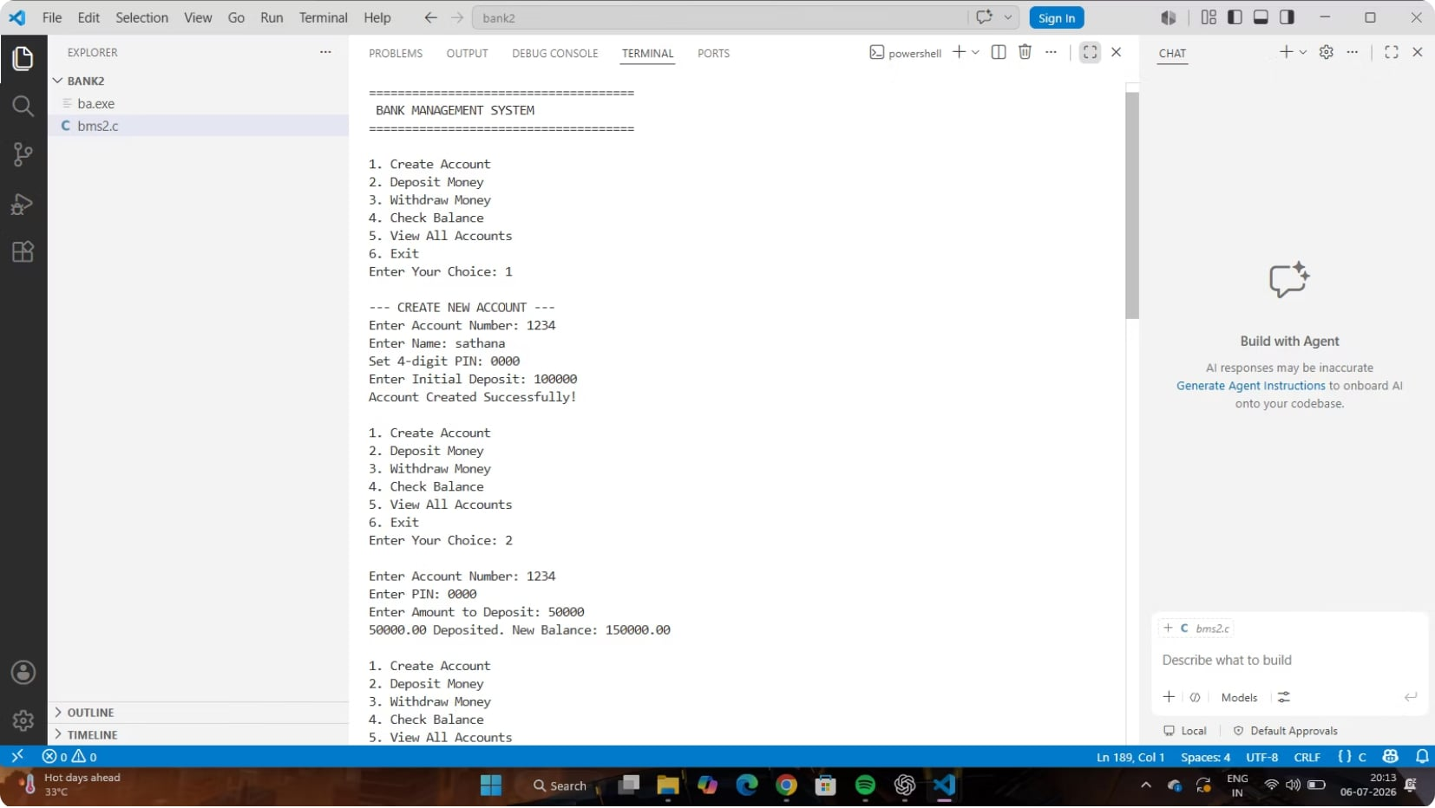
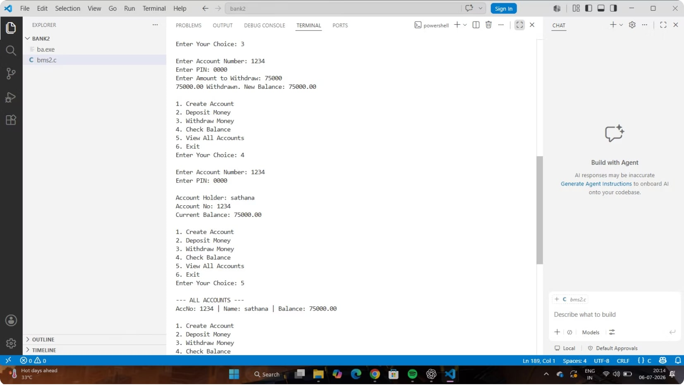
07 — DEMONSTRATION
Output Screenshots
The following screens show the project output for the banking workflow.
Main Menu and Account Operations
Additional Transaction Outputs
The first screenshot shows the banking menu along with the account creation, deposit, withdrawal, and balance-check workflow.
The second screenshot shows additional transaction output screens and the resulting console responses.

Slide 9


Conclusion & Key Benefits
Our Banking Management System delivers a robust and efficient solution for modern banking operations, addressing the limitations of existing systems.
Enhanced Efficiency
Improved Accuracy
Automates routine tasks like account creation and transactions, significantly reducing processing times and operational overhead for financial institutions.
Minimises human error in financial data handling and record-keeping, ensuring reliable data integrity across all banking activities.
Secure Operations
Streamlined Experience
Implements foundational security measures, including PIN protection and data validation, to safeguard customer information and sensitive transactions.
Offers an intuitive, console-based interface that simplifies daily banking for both customers and bank staff, promoting ease of use and accessibility.

